Slide 1
ECON 490
Midterm Presentation
Examining the Correlation between the COVID-19 Lockdown and Crime Number Changes in City of Vancouver
Hanze Wang 39408695
Yuchen Fan 54509832

Slide 2
Abstract
Our study examines the correlation between COVID-19 public health emergency measures and crime patterns in the City of Vancouver.
Used time series data from 2003 to 2024, including socioeconomic and environmental variables, we compare predicted and actual crime numbers before and after March 2020.
Using XGBoost and SARIMA, our analysis reveals a statistically significant difference (p < 0.05) between forecasted and actual crime numbers following the public health emergency declaration.

Slide 3
Data

Slide 4
Main Variables
Dependent Variable
Independent Variables
Actual Crime Number
Date
Minimum Wage
CPI
Temperature
Police Officers Per 100,000 Population
Weighted Clearance Rate
Vancouver Unemployment Rate

Slide 5
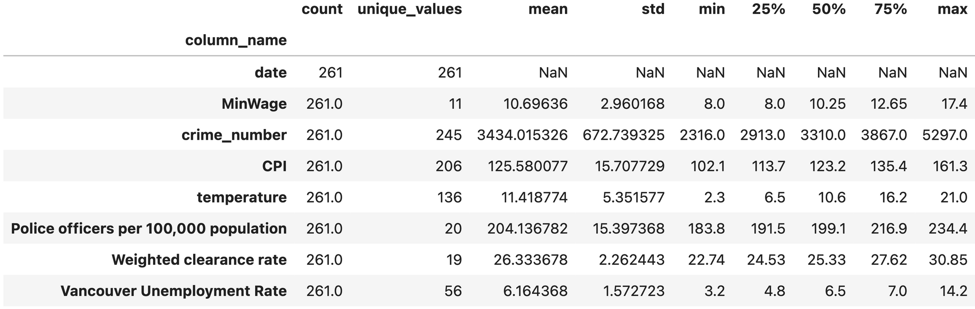
Data description table

Slide 6
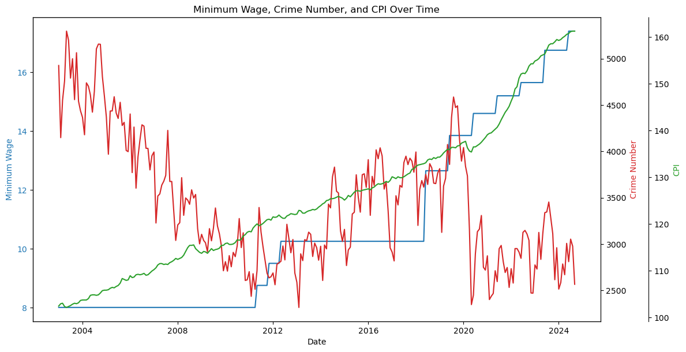

Slide 7
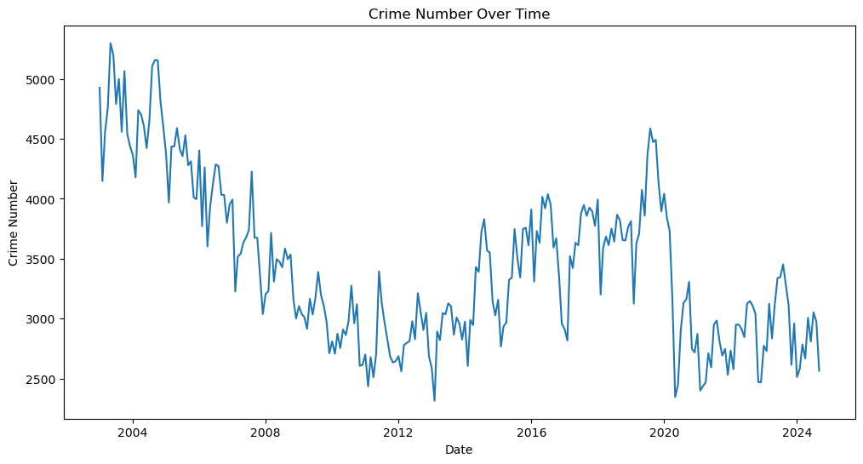

Slide 8
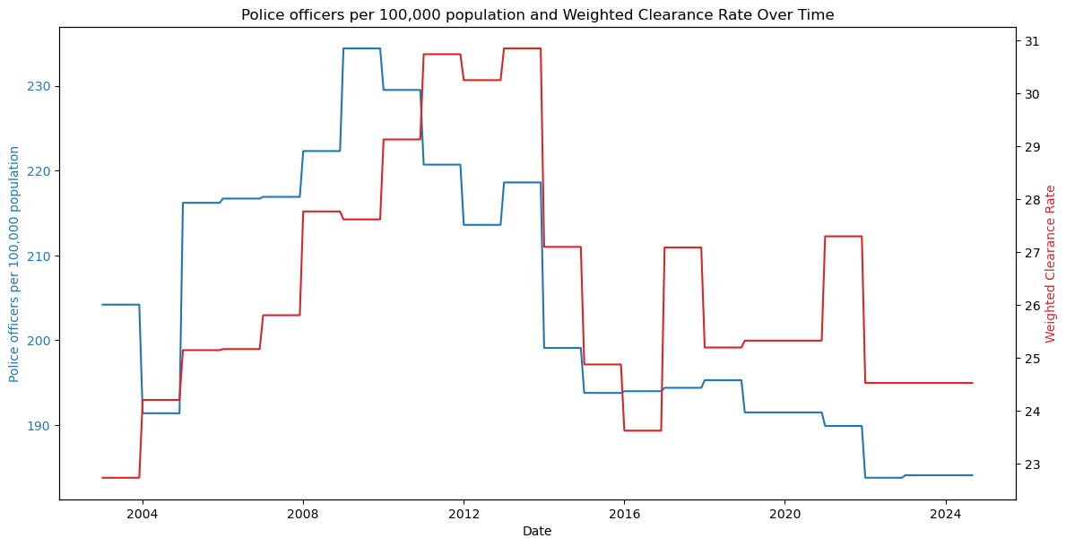

Slide 9
Methodology

Slide 10
1. Data Construction and Preprocessing
We construct a monthly time series dataset spanning from 2003 to 2024, integrating multiple variables including:
Socioeconomic factors: Minimum wage, unemployment rates, and CPI.
Environmental factors: Monthly average temperature.
Law enforcement factors: Police density and weighted clearance rates.
Crime data: Monthly counts of reported crimes.

Slide 11
2. Models
We employ two models to analyze crime patterns:
Statistical Model (SARIMA)
Machine Learning Model (XGBoost)

Slide 12
3. Analysis – Counterfactual
Train models
Predict values
Compare our prediction with actual values

Slide 13
Results

Slide 14
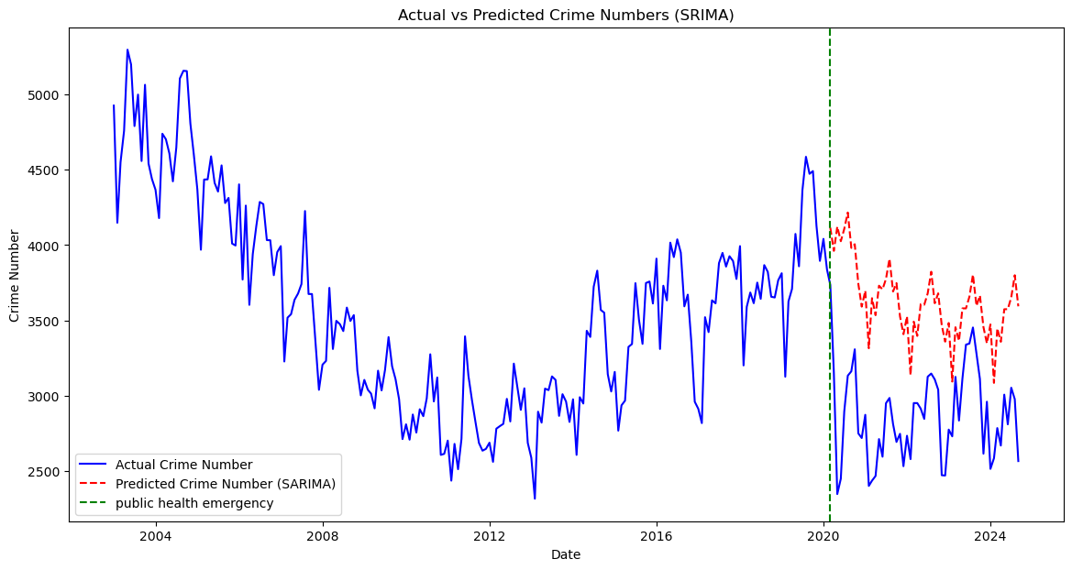

Slide 15
SARIMA
By using the SARIMA model, we observed that there are significant deviations between the predicted and observed crime rates after March 2020 when the BC government announced a public health emergency.

Slide 16
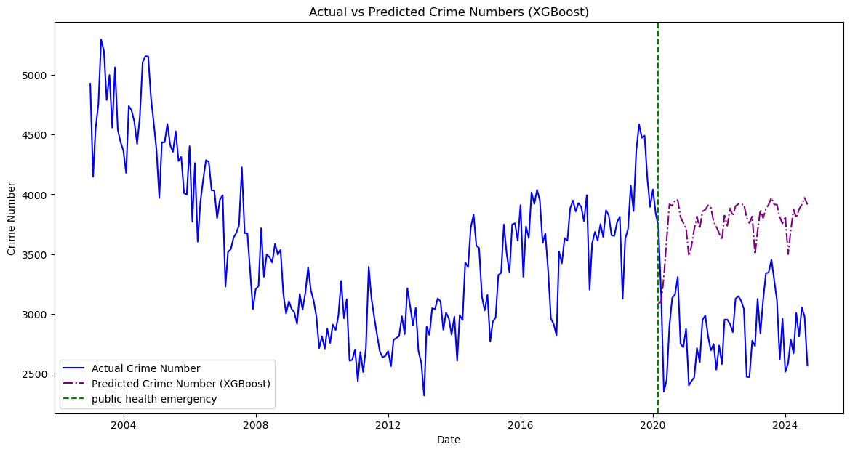

Slide 17
XGBoost
By using the XGBoost model, we managed to predict the crime number as if there are no COVID-19 present.

Slide 18
Conclusion
Both XGBoost and SARIMA models indicate a significant decrease in crime numbers following the COVID-19 public health emergency in City of Vancouver, with observed reductions of 27.45% and 32.63% respectively, suggesting a strong correlation between lockdown measures and reduced criminal activity in Vancouver (p < 0.001).

Slide 19
What’s next…
Implement a validation period (2018-2020) to evaluate model performance, and use this pre-pandemic period to assess prediction accuracy of both XGBoost and SARIMA models
Transform the dataset from monthly to weekly or daily to increase the data size for future analysis.

